Slide 1


Chatbot Using Rasa NLU
Manish Katheeth - 20
Yashvi Desai - 21
Nikhil Mishra - 22
Chinmay Tawde - 23
Project Guide:- Prof. Valentina Rani

Slide 2
INTRODUCTION
Chatbot - AI software
Function - Simulate a human conversation with user through messaging applications or websites
Applications - Interactions between people and services improving Customer Experience and their Engagement process
Advantages - Efficiency, Reduced cost of service, Availability 24*7

Slide 3
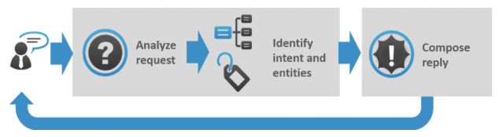
HOW DOES A CHATBOT WORK?
There are two different tasks at the core of a chatbot:
User request analysis
Returning the response
Figure 1: Working of a chatbot [3]

Slide 4
PROBLEM STATEMENT
To construct a domain-specific model to converse with humans for restaurant and cuisine suggestions.

Slide 5
MOTIVATION
Current chatbots are for General purposes
(eg: personal assistance, healthcare, bank queries)
Delay in reply or unreliable data
Retrieval based system with small dataset

Slide 6
LITERATURE SURVEY
.
Sr. No. | IEEE Paper | Author | Dataset | Problems faced
i | Sequence to Sequence Learning with Neural Networks | I. Sutskever, O. Vinyals, Q. Le | WMT’14 English to French dataset | Difficulty in translating long sentences and unable to train standard RNN
ii | End to end Adversarial learning for Generative Conversational Agent | O. Ludwig | Human generative data set | Open domain and fraction of margin errors
iii | A Neural Conversational Model | O. Vinyals, Q. Le | Closed domain IT help desk and open domain movie transcript dataset | Unable to deliver realistic conversations and lacks human touch

Slide 7
.
.
Sr. No. | IEEE Paper | Author | Dataset | Problems faced
iv | Towards a Framework for Classifying Chatbots | D.Braun, F.Matthes | -- | -
vv | Rasa: Open Source Language Understanding and Dialogue Management | T.Bocklisch, J.Faulkner, N.Pawlowski, A.Nichol | -- | -

Slide 8
WHAT IS RASA?
An open source Conversational AI framework
Consists of 2 main components — Rasa NLU and Rasa Core
NLU : Extract input, understand the intent of user and find the entities in input
Rasa Core : Takes output of Rasa NLU and apply ML models to generate reply

Slide 9
WHY RASA?
Open source and flexible bot building framework
No rule based framework like Botkit
No restrictions while uploading data on cloud unlike other 3
RASA | Dialogflow | Microsoft LUIS | Amazon Lex
Open source,code available in GITHUB | Closed System | Closed System | Closed System
Documentation provided is interactive in RASA | Documentation provided is in intermediate language | Documentation provided is in intermediate language | The user must have previous experiences with chatbots and ML
Completely customizable | Customization is restricted to some extent | Customization is restricted to some extent | Customization is restricted to some extent

Slide 10
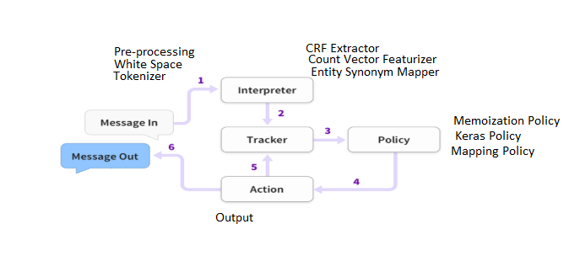
HOW RASA WORKS?
Figure 3: Architecture of RASA [5]

Slide 11
RASA NLU
Bag-of-Word (BoW) algorithm to find intent.
Steps:
Collect Data
Design the Vocabulary
Create Document Vectors
Limitations - Vocabulary, Sparsity, Meaning

Slide 12
Pipeline of NLU
Language:en
pipeline:
-name: WhitespaceTokenizer
-name: CRFEntityExtractor
-name: CountVectorsFeaturizer
-name: EmbeddingIntentClassifier
-name: EntitySynonymMapper
policies:
-name:MemoizationPolicy
-name:KerasPolicy
-name:MappingPolicy

Slide 13
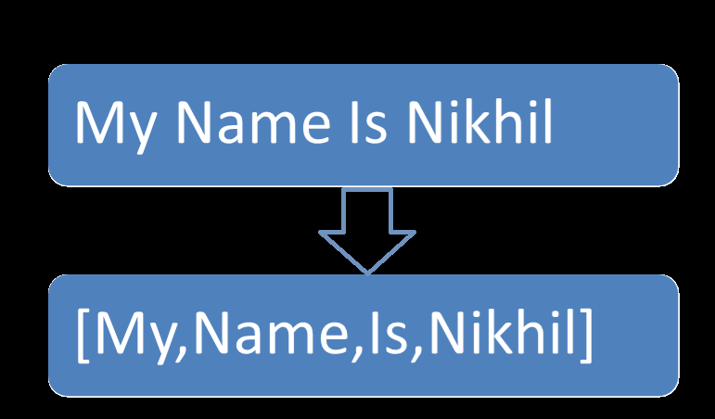
White Space Tokenizer
Creates a token for every whitespace separated character sequence
E.g:
Parameters:
1)max_token_length: The Maximum token length

Slide 14
CRF Entity Extractor
Conditional Random Fields (CRF):
i) Sequence modelling algorithm to find entities
ii) Every feature is dependent on features (tokens) before and after it
iii) Best method for entity recognition problem
ML models can be classified as: Generative and Discriminative
Mathematical Overview of CRF:
https://docs.google.com/document/d/1gEJ5u5v8owbKGtbyv7ZZyFikgHzpfcErxNubXWy5WG0/edit

Slide 15
Count Vectors Featurizer
Creates features for intent classification and response selection
Creates bag-of-words representation of user message and label (intent and response) features
The returned matrix of the featurizer will have the size (token-length x feature-dimension). So, the returned matrix will have an entry for every token.
Feature-dimension: Non zero values and their positions in the vector.

Slide 16
Embedding Intent Classifier
The embedding intent classifier embeds user inputs and intent labels into the same space.
The embedding intent classifier needs to be preceded by a featurizer in the pipeline. This featurizer creates the features used for the embeddings.
Outputs: intent and intent_ranking

Slide 17
Example of Embedding intent classifier
{
"intent": {"name": "greet", "confidence": 0.8343},
"intent_ranking": [
{
"confidence": 0.385910906220309,
"name": "goodbye"
},
{
"confidence": 0.28161531595656784,
"name": "restaurant_search"}]}

Slide 18
Entity Synonym Mapper
Maps synonymous entity values to the same value.
If the training data contains defined Synonyms this component will make sure that detected entity values will be mapped to the same values.
E,g:This component will allow you to map the entities New York City and NYC to nyc. The entitiy extraction will return nyc even though the message contains NYC.
[{ "text": "I moved to New York City",
"intent": "inform_relocation",
"entities": [{"value": "nyc",
"start": 11,
"end": 24,
"entity": "city", }]},
{"text": "I got a new flat in NYC.",
"intent": "inform_relocation",
"entities": [{"value": "nyc",
"start": 20,
"end": 23,
"entity": "city",}]}]

Slide 19
Policies: 1) Memoization Policy
The MemoizationPolicy just memorizes the conversations in your training data.
It predicts the next action with confidence 1.0 if this exact conversation exists in the training data
Otherwise it predicts None with confidence 0.0.

Slide 20
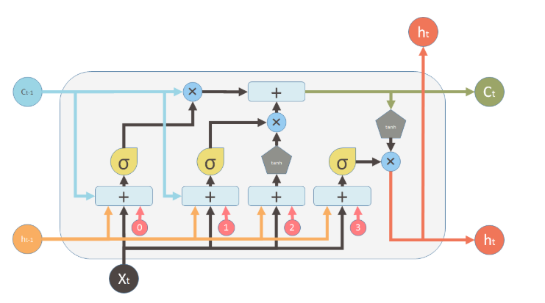
2) Keras Policy
The KerasPolicy uses a neural network implemented in Keras to select the next action.
The architecture of this neural network is based on LSTM.

Slide 21
LSTM
Vanishing gradient problem can be solved using LSTM
The single unit makes decisions by considering the current input, previous output and previous memory. Generates a new output and updates the memory.
There are 4 various stages in how LSTM works:1) Forget Gate 2) Input Gate 3) Cell State 4) Output Gate

Slide 22
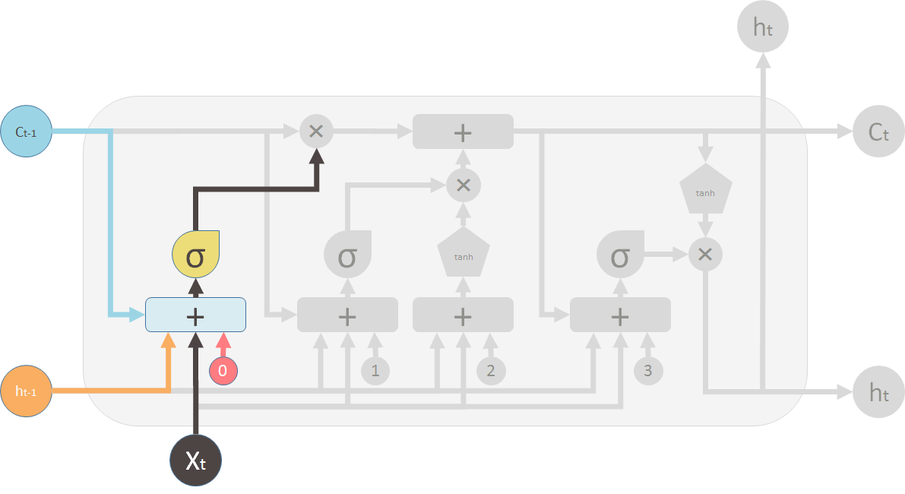
Working of LSTM
1)Forget Gate:
The information from the previous hidden state and the information from the current input is passed through the sigmoid function.We get a value between 0 and 1. Based on the value lstm decides if that information is important for future use. Values closer to 0 means not important, while the one closer to 1 means important.

Slide 23
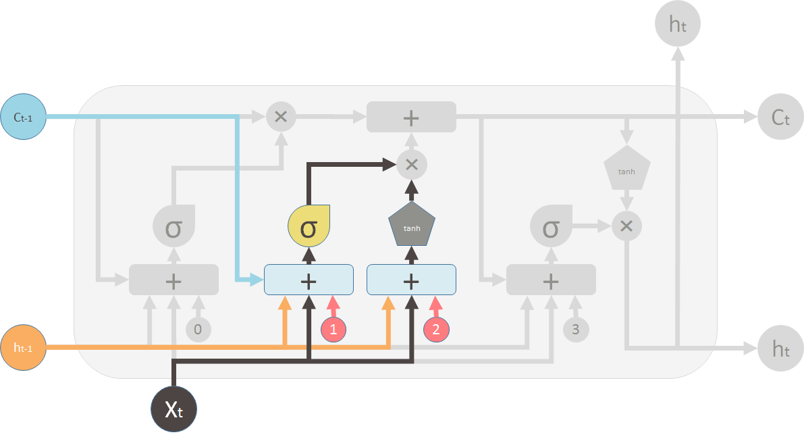
2)Input Gate:
In this gate, first we pass the previous hidden state and current input into a sigmoid function. We get the value between 0 and 1. If it’s closer to 0 we don’t update the information, if it’s closer to 1 we update the information. Then we pass the hidden state and current input into the tanh function and we get the values between -1 and 1. Then we multiply the tanh output with the sigmoid output. The sigmoid output helps us decide which information is important to be kept from the tanh output. This gate is used to update the cell state.

Slide 24
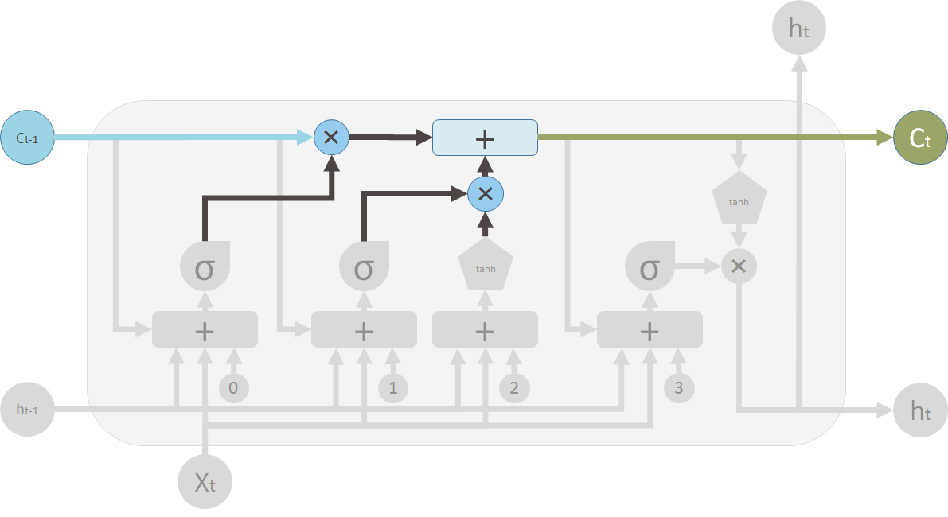
3)Cell State:
First, the cell state gets pointwise multiplied by the vector of the forget gate. The values of the cell state which are multiplied by the zeroes are dropped. Then the values of the cell state still kept are pointwise added with the output from the input gate which updates the cell state to new values. That gives us our new cell state.

Slide 25
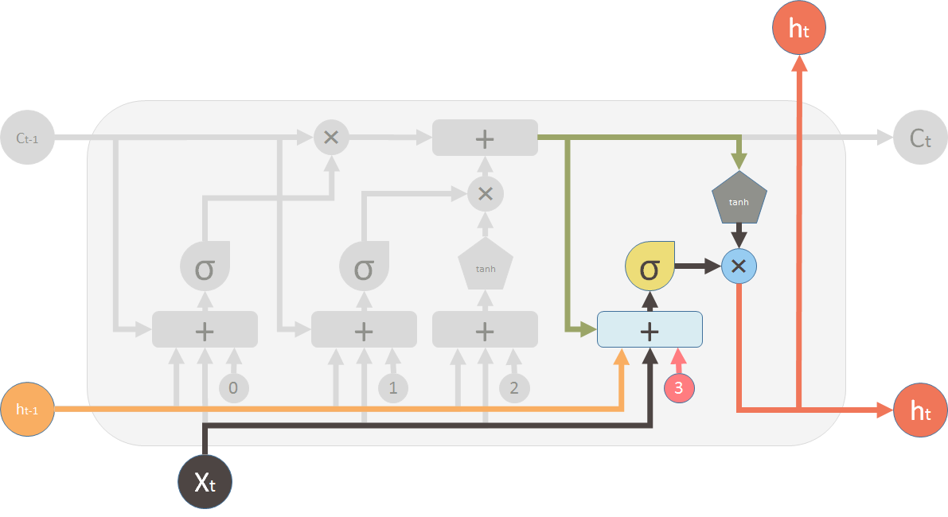
4)Output Gate:
This gate helps us decide what the next hidden state should be. First, we pass the previous hidden state and the current input into a sigmoid function. Then we pass the newly modified cell state to the tanh function. We multiply the tanh output with the sigmoid output to decide what information the hidden state should carry. The output is the hidden state of the current cell. The new cell state and the new hidden is then carried over to the next LSTM cell. The hidden state is used for predictions.

Slide 26
3) Mapping Policy
The MappingPolicy can be used to directly map intents to actions.
The mappings are assigned by giving an intent the property triggers
An intent can only be mapped to at most one action.
The bot will run the mapped action once it receives a message of the triggering intent.
For the next user message, normal prediction will resume.

Slide 27
SPACY
Free, open-source library for advanced NLP
Helps to build applications that process and understand large volume of texts.
Features:
Tokenization
Parts-of-speech (POS) tagging
Dependency parsing
Lemmatization
Named Entity Recognition (NER)

Slide 28
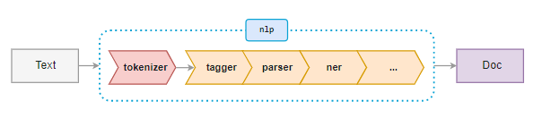
PIPELINE
When NLP is performed on text:
i) Spacy tokenizes the text to produce a Doc object.
ii) Doc is processed in several steps referred to as processing pipeline.
iii) Pipeline used by default models comprises of the following:
Figure 4: Components of pipeline

Slide 29
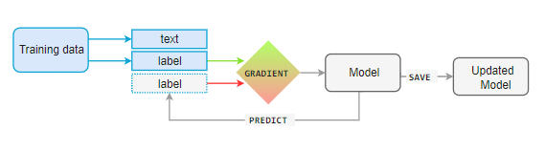
TRAINING
Spacy models are statistical and decisive
For eg.: which POS tag to assign, whether a word is to be named as an entity or is a prediction .
The prediction is based on the examples the model has seen during training.
Figure 5: training the model in spaCy

Slide 30
SVM
Supervised ML algorithm used for classification or regression problems
Finds optimal boundary between possible outputs
Post data transformations, separate data based on labels or outputs
Algorithm output is optimal hyperplane to categorize new examples

Slide 31
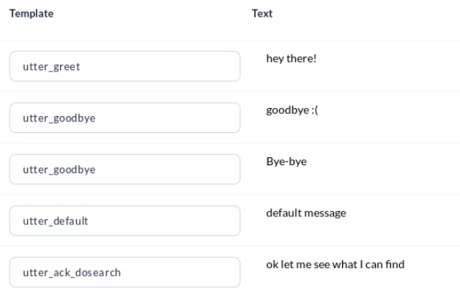
Template Training
Figure 6: example of template training 1 Example

Slide 32
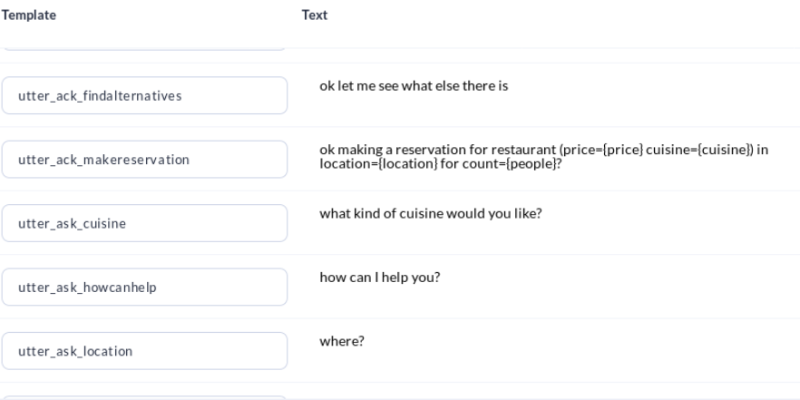
Template Training
Figure 7: example of template training 2

Slide 33
REFERENCES
[1] Oriol Vinyals, Quoc V.Le ,”A Neural Conversational Model” [July 22, 2015]
[2] Tom Bocklisch, Joey Faulkner, Nick Pawlowski, Alan Nichol, “Rasa: Open Source Language Understanding and Dialogue Management” [December 15, 2017]
[3] "Chatbot: What is Chatbot?Why are Chatbots Important?,"expertsystem,n.d.[Online].
Available:https://www.expertsystem.com/chatbot/. [Accessed: August 20, 2019].
[4] "Essentials of Deep Learning – Sequence to Sequence modelling with Attention (using python),"analyticsvidhya,n.d.[Online].Available:https://www.analyticsvidhya.com/blog/2018/03/essentials-of-deep-learning-sequence-to-sequence-modelling-with-attention-part-i/. [Accessed: August 20, 2019].
[5]"Architecture,"rasa,n.d.[Online].Available:https://rasa.com/docs/rasa/user-guide/architecture/#architecture. [Accessed: August 20, 2019].

